Slide 1
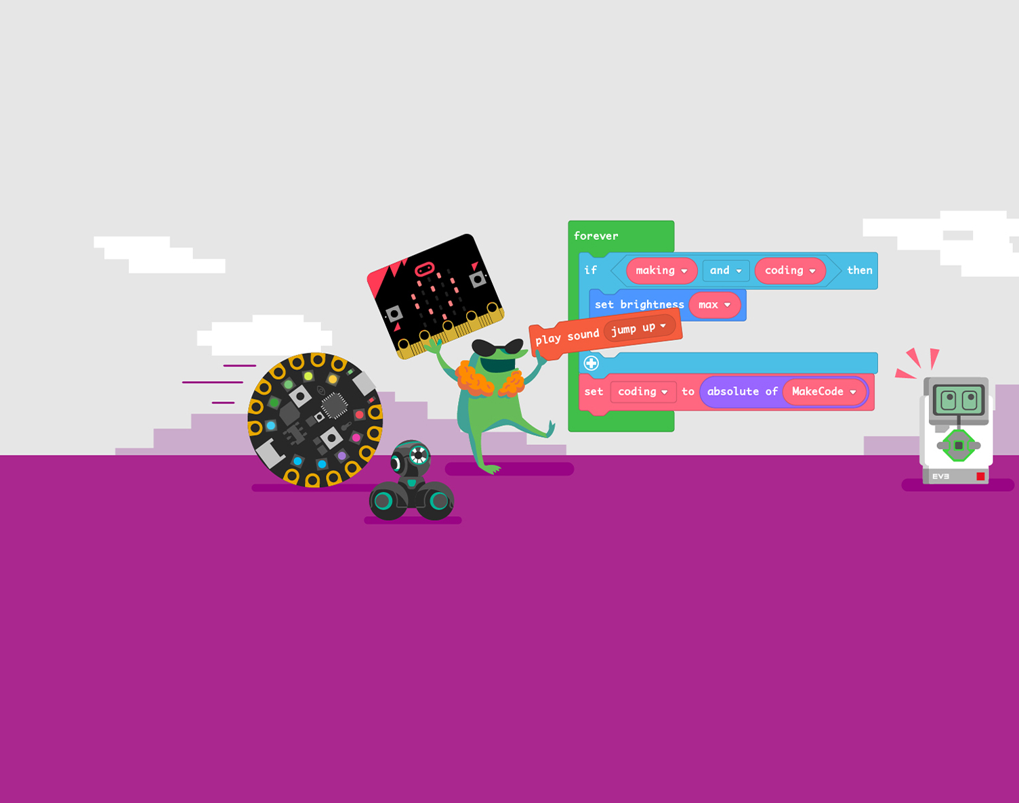
Computer Game Coding Camp 2021 Feedback

Slide 2
Questions
If you got any outside feedback about your game, what did you learn?
What is the most important lesson you learned in this class?
What do you want to be when you grow up?
What has been your most improved skill since being this course?
If you could change one thing about this coding camp, what would it be?

